Slide 1

SFG135171
Short <1 21 22 23…974 979>-GND-> Parts:Y17.4;<32 358 427 683>-1V2_BMC-> Parts:M2.96;
Prepared: PE Toan
2026年04月15日

Slide 2
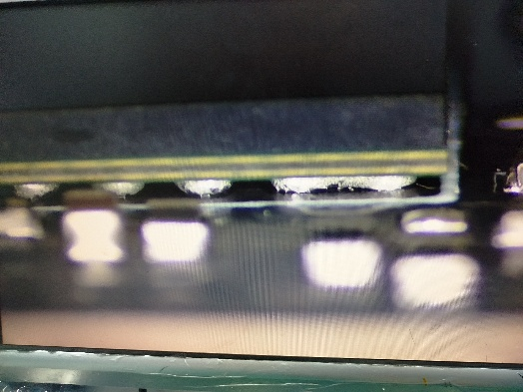
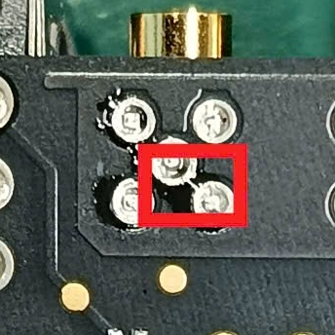
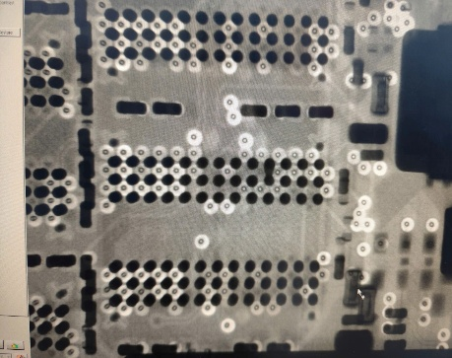
SFG302185- Short <1 21 22 23…974 979>-GND-> Parts:Y17.4;<32 358 427 683>-1V2_BMC-> Parts:M2.96;
Problem description(5W2H) |  |  | Root cause analysis | 改善對策(Improvement Action)
When: 2026-04-15 | Who: PE Toan | Where: F06 | Defect symptom: ICT fail: Short circuit The same short circuit symptom was also detected at multiple locations U99 / DDR / J13 / J14,… FA process: Visual inspection (CCD) detects short circuit at multiple locations (J13, J14, etc.). ICT retest: FAIL (same symptom). X-ray analysis confirmed solder bridging at U99 / DDR area, which caused the short circuit. After cleaning and rework → ICT retest PASS. Consistent defects across multiple locations confirm a systemic SMT process instability rather than an isolated issue. Conclusion: Process issue | Action: Notify all relevant departments to align and take necessary actions before ICT.
What | SFG135171 ICT Station
Why | Process issue
How | Short circuits are caused by solder bridging and solder residue.
How Much | DFR: 15/7860(~0.2%) (From 0h00:14/04 to 8h30-15/04)
Check
VI_CDD
Retest
-> FAIL
Xray
PASS
Short U99
Short J13
Short DDR

Slide 3


